Slide 1
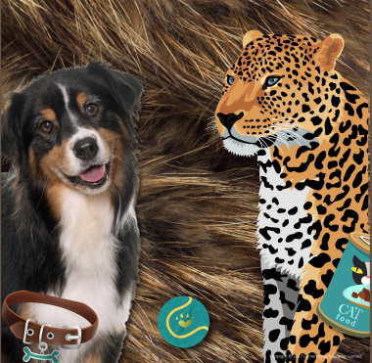
Paws, Claws and Whiskers– My Learning Journey.
Science
Test
Explore camouflage by completing a butterfly hunt.
Draw and label
Identify the similarities and differences between the human body and big cats.
Identify
Identify variation by looking at similarities and differences.
Sort and classify
Sort and compare familiar animal species.
identify
Create a class list of interesting animal facts.
Sort and Identify
Sort domestic animals according to what they eat.
Art and Design
Observe
Look at and talk about animal paintings, drawings and sculptures.
Cut
Make animal masks..
Create
Create patterns using collage and print materials..
Paint
Make large scale paintings of big cats.
Use
Draw a range of pets either from memory or from a photograph.
Memorable experience – Visit from Angus the dog.
Create
Create an imaginary version of a familiar pet.
Manipulate
Make 3D models/sculptures of big cats.
Talk
Talk through the gallery that has been created.
Express event – Art gallery.
Design and Technology
Draw
Design and make a can of tiger food.
Design
Design and make an enclosure for a zoo animal.
Geography
Find
Locate where big cats live across the world.
Draw
Design a zoo or wildlife park.
Find and name
Find where different zoo animals live in the wild.

Slide 2
Paws, Claws and Whiskers – My Learning Journey.
Computing
Format
Find and save a range of zoo animals to be saved for presentation.
Music
Perform
Perform a variety of animal songs to an audience.
Memorable experience – Visit from Angus the dog..
Express event – Art gallery.

