Slide 1
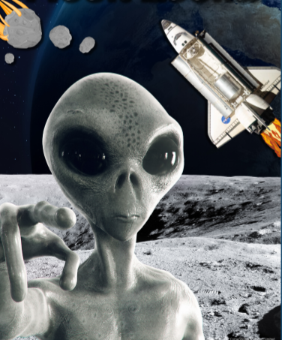
Moon Zoom – My Learning Journey.
Computing
Give instructions
Create and use an alien landscape for a programmable toy.
Discuss
Write and send an email to discover where the spaceship might have come from.
Complete
Use drawing software to create an alien, describing different features.
Follow instructions
Create a photo story to show all we have learnt,
Design and Technology
Draw
Draw and make a model of an alien spaceship.
Describe
Explore and evaluate a range of space toys suggesting improvements.
Use
Look at, explore and draw a range of moving vehicles.
Talk about
Work with a partner to review the models that have been made.
Memorable experience – alien crash landing investigation.
Express event – out of this world exhibition.
PE
Perform
Create and perform an alien dance using music to support.
Music
Make
Read, learn and perform space themed songs adding percussion sounds..
Represent
Create space sounds using pictures to represent sounds.

Slide 2
Moon Zoom – My Learning Journey.
Science
Name
Make a ‘welcome to Earth’ pack for an alien to investigate materials.
Talk
Create a working circuit, discuss how to create an alien code.
Group and sort
Sort different objects according to the material they are made of.
Use language
Gather and record data about the moon and planets in our Solar System.
Describe
Investigate the properties of different materials using the senses.
Explore
Investigate if balloon size affects how a balloon rocket travels.
Follow instructions
Make mini exploding rockets.
Answer
Create and launch a rocket into space.
History
Sequence
Listen to and sequence the story of Yuri Gagarin.
Describe
Explore a selection of dated space history events.
Memorable experience – alien crash landing investigation
Express event – out of this world exhibition.
Art and Design
Apply
Create the solar system using papier mache.
Geography
Describe
Use the NASA website to explore images of Earth from outer space.

