Slide 1
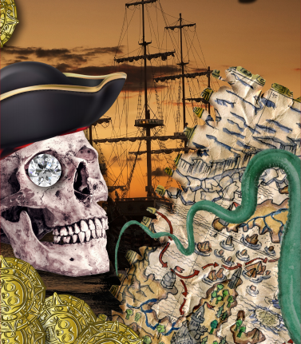
Land Ahoy – My Learning Journey.
Computing
Reasoning
Debug a program to prevent the ‘ship’ from crashing.
Follow instructions
Create a photo story to show all we have learnt,
Design and Technology
Create and use
Make a boat with a moving mechanism..
Use
Design and create a working lighthouse.
Improve
Make and develop a working rescue craft.
Talk about
Work with a partner to review the models that have been made.
Memorable experience – Visit to Harwich RNLI station and harbour.
Express event – land ahoy exhibition.
PSHE
Share
Discuss and prepare what will be presented during the Express event.
Music
Make
Read, learn and perform space themed songs adding percussion sounds..
Use
Listen to and join in with sea shanties or traditional songs sung about sailors.
Perform
Perform a range of sea shanties to an audience.

Slide 2
Land Ahoy – My Learning Journey.
Science
Sort
Identify the materials boats are made from and their properties.
Describe
Explore how shape affects a materials ability to float.
History
Use
Use a range of non-fiction books to find and present information about pirates.
Use
Make a timeline to show the journey of a famous sea explorer.
Use
Find out and explore about a famous sea explorer.
Memorable experience – Visit to Harwich RNLI station and harbour
Compare
Act out the life story of a famous sea explorer.
Express event – land ahoy exhibition.
Art and Design
Use line and tone
Draw a boar looking at shape and form.
Develop
Design and create a pirate flag.
Geography
Name and locate
Identify and name the seas surrounding the UK.
Locate
Plan and navigate Captain Cook’s journey around the world.
Draw
Create an imaginary treasure map adding lots of exciting features.
Name
Use information gathered to find and locate RNLI stations in the UK.
Use direction
Use compass directions to play sea related playground games.

