Slide 1
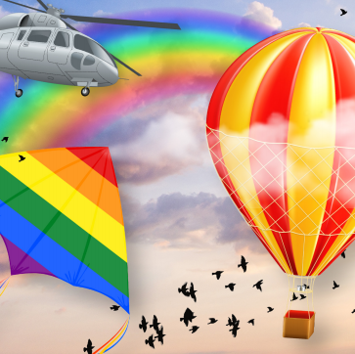
Splendid Skies – My Learning Journey.
Science
Observe
Explore clothes that are suitable for the different seasons.
Develop
Play outside on a windy day. explore an anemometer.
Develop
Play outside on a rainy day, Create a rain gauge to collect and record totals
identify
Explore the effect of light and heat on thermo beads and paper.
Observe
Use a thermometer to record the temperature.
Develop
Make shadows and explore how they move during the day.
Use
Analyse weather records and make conclusions about findings.
Art and Design
Learn
Explore making cloud structures in the style of Berndaut Smilde..
Use
Make season trees, talk about the use of materials.
Learn
Talk about and explore weather themed painting by famous artists.
Memorable experience – Autumn walk and weather watch.
Express event – creation of a weather station.
Music
Listen
Listen to classical music that represents the seasons.
Use
Listen and join in with nursery rhymes about the wind.
Experiment
Read, learn and join in with poems about the rain.
Use
Perform a weather related song with percussion.
History
Learn
Read the story of Sir Francis Beaufort. Explain why he was important.

Slide 2
Splendid Skies – My Learning Journey.
Geography
Identify
Work out the current season and seasonal weather. Create a daily weather chart.
Identify
Watch videos of extreme weather. Discuss consequences of weather situations.
Use
Use a variety of aerial photographs to spot significant landmarks.
Identify
Explore maps and globes to find the equator and countries located near it.
Understand
Identify the climate in Antarctica and Africa, discuss the differences.
Physical Education
Perform
Explore different movements to create a dance in the wind.
Perform
Perform the windy day dance.
Memorable experience – Autumn walk and weather watch..
Express event – Creation of a weather station.

