Slide 1
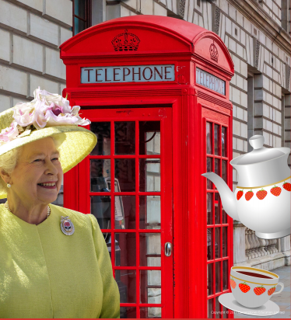
Bright Lights, Big City – My Learning Journey.
Computing
Follow instructions
Follow a virtual tour of Buckingham Palace.
Follow instructions
Create an image of the Royal Family.
Give instructions
Write an algorithm to travel around London
Follow instructions
Copy, paste and print images of London landmarks.
Discuss
Explore ZSL London Zoo website..
Use
Use movie maker software to create stop motion animations.
Geography
Locate
Identify the countries that make up the UK.
Identify
Look at the buildings surrounding Buckingham Palace.
Recognise features
Explore maps and plans of London.
Identify
Explore similarities and differences between London and Lusaka.
Memorable experience – Afternoon tea with Her Majesty the Queen.
Express event – Plan a trip around London to take in all the sights.
Design and Technology
Use
Design and create a moving model based on a form of transport.
Build
Design and build a model of the London Eye.
Put ideas into practice
Make souvenirs for the zoo’s gift shop.
Select and explain
Create junk models of famous London landmarks.
Identify
Bake bread.
Music
Sing
Learn traditional and contemporary songs linked to London.

Slide 2
Bright Lights, Big City – My Learning Journey.
Science
Identify
Make models of Pudding Lane. Explore why materials allowed the fire to spread quickly.
Use language to answer a question
Recreate Pudding Lane, explore why it burnt so quickly.
Memorable experience – Afternoon tea with Her Magesty the Queen.
Express event – Plan a trip around London to take in all the sights.

