Slide 1
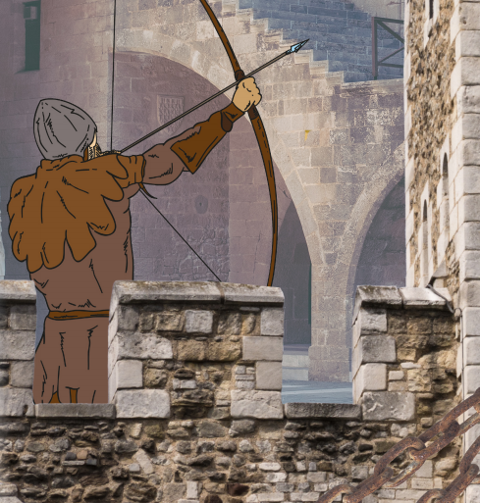
Towers, Tunnels and Turrets – My Learning Journey.
History
Learn
Look at a range of castles and create a timeline.
Understand
Find out about the ‘Great Escape’.
Design and Technology
Build
Use sand to explore how to tunnel and what happens if it becomes wider.
Evaluate
Write about what has been learnt and found out about building different structures.
Select
Create a model castle using recycled materials.
Select
Build stacks and towers out of natural materials.
Build
Use a range of construction materials to explore building towers.
Build
Construct a bridge using spaghetti and marshmallows.
Explore
Explore structures created by Isambard Kingdom Brunel.
Memorable experience – Virtual tour of a castle.
Express event – creation of a fortress for the Three Little Pigs.
Computing
Use
Draw and label a castle using drawing software.
Science
Identify and name
Explore tunnelling animals, their lifecycles and how tunnelling helps them.
Test
Explore the weight different shapes bridges can hold.
Perform
Plan and carry out a test to find out which biscuit makes the best bridge.
Gather and record
Build a wooden castle to then test the weight and material of projectile that causes the most damage.
Observe
Using sugar cubes explore how to build the most stable tower.
Observe
Sort different bridges according to the materials they are built out of.

Slide 2
Towers, Tunnels and Turrets – My Learning Journey.
Geography
Use
Explore where great towers are located across the world on a map.
Use
Explore a range of famous tunnels and discuss why they are needed.
Use
Explore what bridges are used for and look at the different shapes and designs used.
Understand
Explore famous structures from across the world. Locate where they are using geographical vocabulary.
Physical Education
Movement
Play a range of defend and attack games.
Movement
Explore balances using different contact points.
Movement
Work as a team to build a structure that crosses a space.
Memorable experience – Virtual tour of a castle.
Express event – Creation of a fortress for the Three Little Pigs.

