Slide 1
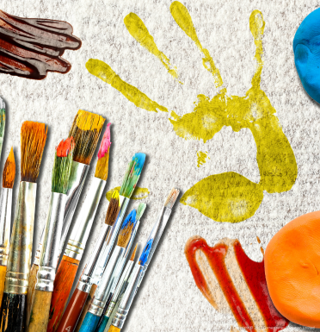
Muck, mess and mixtures – My Learning Journey.
Science
Gather, record and talk
Investigate how everyday materials change when water is added.
Observe
Explore how different foods melt.
Test
Explore which produce makes the best bubbles.
Find out
Make ice cream in a bag.
Describe
Make flavoured bread dough.
Explore
Explore liquids that don’t mix.
Use
Reflect on and choose a favourite, explain why and how to do it.
Art and Design
Create
Use marbling inks to create multicoloured prints.
Develop
Look at and create a food landscape inspired by Carl Warner.
Create
Collaborative ice cube paintings.
Choose
Experiment with art and craft materials.
Create
Explore the properties and consistency of clay.
Mix
Explore how paint mixes.
Memorable experience – Messy mixtures morning.
Express event – Big messy online art exhibition.
PSHE
Recognise
Talk about hazards of touching dangerous mixtures and potions.
Design and Technology
Work safely
Create rainbow jelly
Explain
Sort food to show where it comes from.
Recognise
Sort foods into those that are healthy and unhealthy.
Work safely
Follow a recipe to make something using food that melt.
Produce
Design and help to set up a messy mud kitchen.
Work safely
Taste a range of food from around the world.

Slide 2
Muck, mess and mixtures – My Learning Journey.
Computing
Organise, store, manipulate and retrieve
Create a dough ball animation.
Organise, store, manipulate and retrieve
Create a powerpoint presentation to show what has been learnt.
Memorable experience – messy mixtures morning.
Express event – Big, messy online art exhibition.

