Slide 1
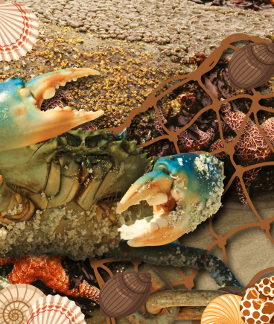
Beachcombers – My Learning Journey.
Science
Perform a test
Examine contents of salt water specimens.
Explain
Explore and examine different types of seaweed.
Observe
Watch how materials degrade in salt water.
Sort and classify
Sort items according to where they can be found at the beach.
Compare
Explore the hostile habitat of a rock pool.
Identify
Find out more about soft shelled crustaceans.
Define
Keep a tally of all the living things found at or around the beach.
Use
Explore the similarities and differences between shells.
Decide
Examine a range of sea creatures
Observe
Explore water proof qualities of feathers.
Art and Design
Use
Make a 3D model of a seashore creature out of clay.
Develop ideas
Create a home for a crustacean.
Create
Make beachcomber art using shells, pebbles and driftwood.
Develop
Look at seascape paintings before using paint and mixed media to create own.
Sketch
Make a beachcombers sketch book to record ideas.
Memorable experience – Beach and undersea experience.
Express event – Beachcomber presentation.
Design and Technology
Use
Make a finger puppet sea bird using felt.
Computing
Organise, store and manipulate
Find out about crustaceans.
Recognise
Search for and watch footage of sea birds in their natural habitat.
Organise, store and manipulate
Create a beachcomber presentation.

Slide 2
Beachcombers – My Learning Journey.
Geography
Use geographical language
Identify and name the coastline’s physical features.
Memorable experience – Beach and undersea experience.
Express event – Beachcomber presentation.

