Slide 1
Read, Write Inc.
Phonic workshop for parents and carers.

Slide 2
Children who read at home do well at school.
Oxford University Press and Ruth Miskin (the creator of RWI) say that reading at home helps;
Read fluently,
Speak articulately,
Write confidently.

Slide 3
Why RWI phonics?
It is a complete literacy programme that is systematic and structured.
It meets the demands of the new national curriculum that gives your children the best chance of success.
Opportunity of one-to-one tutoring so that no child is left behind
Story books linked to the sounds your children already know.

Slide 4
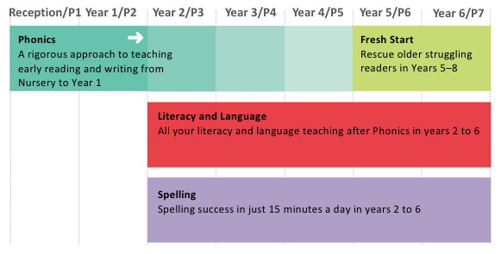
Who is phonics for?
helps;

Slide 5
So what is phonics?
Phonics are the sounds in our language.
In English we have 26 letters in the alphabet …
However …
We use 44 different sounds to help us read, write and spell different words.

Slide 6
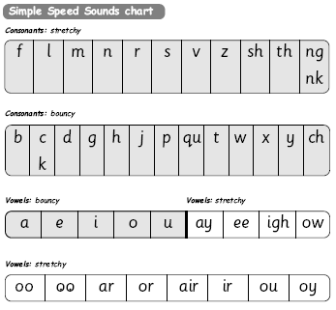
This chart you will see in the classroom.
It shows the first sounds we learn to help us read and then write. It shows single sounds and ones that are blended together to make a new sound.

Slide 7
English is a very complex code.
In English we have a number of different ways to spell the same sound.
It would be easy if we just learnt sets 1 and 2 (shown in the previous chart).
ay | igh
play eight cake straight | right pie kite fly

Slide 8
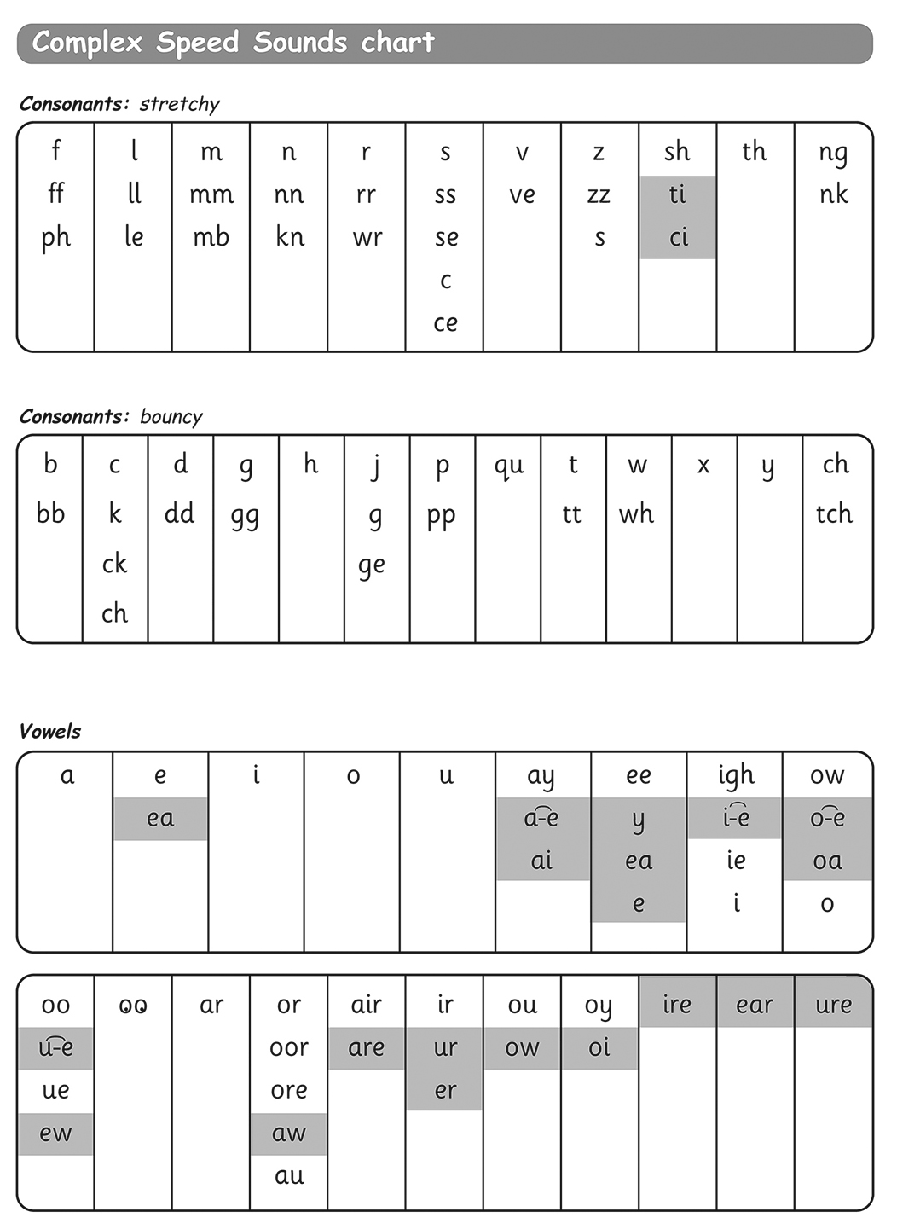
Here is the complete list of sounds that your child will learn.

Slide 9
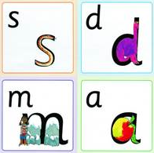
How can you help at home?
You can help your child by pronouncing the sounds at home. If you are not sure what the sound ‘sounds’ like either ask your child or ask me.

Slide 10
How can you help at home?
Listen or read to your child on a daily basis. If they are tired when they come home, spending time sharing stories together will help them to develop a love of reading.
If you come across words that children are unsure of (and they are green or black), you can use Fred talk to sound them out to make the word.

Slide 11
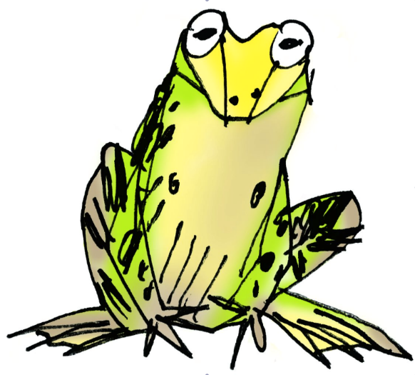


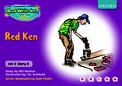

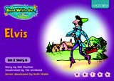
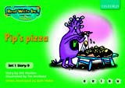




What is Fred talk?
When you are reading the RWI books,
if the word is black or green you can
use Fred talk. Fred can only talk in sounds.
Fred says
c_a_t
rather than cat.
If the word is red you
just have to know it.

Slide 12

Support materials.
If you would like any further information or support, have a look at www.ruthmiskintraining.com/parents
There are a number of good video tutorials that can help. I would recommend
Teaching sound blending and
Independent blending.
Like the Ruth Miskin Training parents’ page – trainer top tips and book recommendations.

