Slide 2
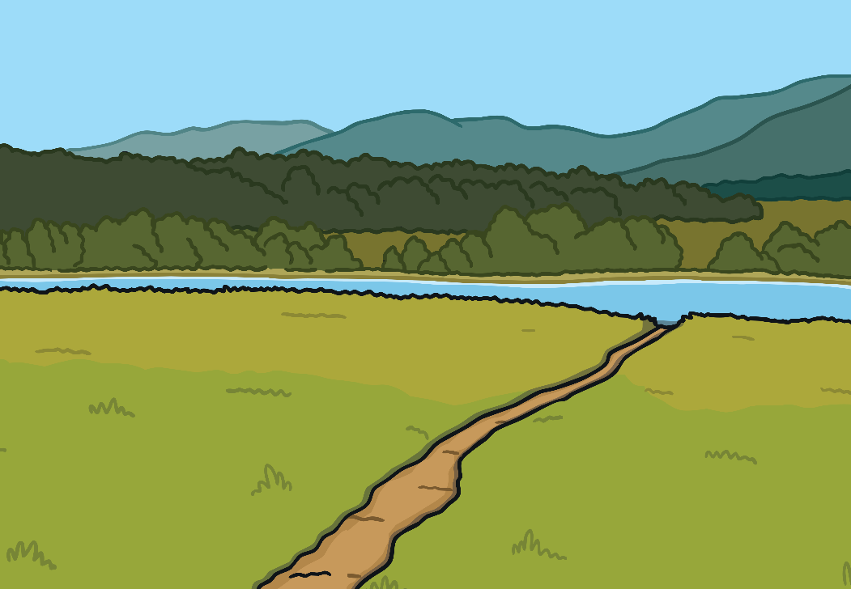
Our Planet
Our planet is amazing and beautiful. Think about your favourite outside place.
Is it the seaside? The countryside? A park? What do you like about this place? What makes it special?

Slide 3
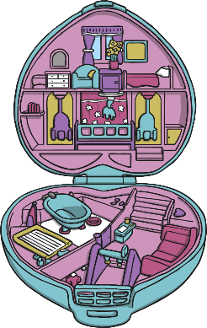
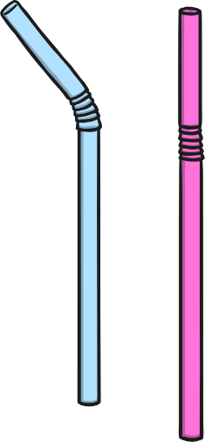
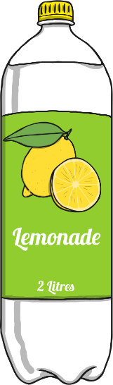
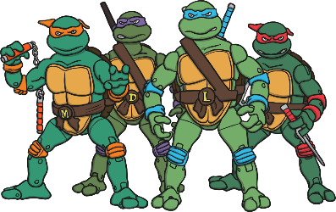
Plastic
Plastic is everywhere. Toys can be made from it, so can drinks bottles. Drinks straws are usually made from plastic and lots of food is wrapped in it.

Slide 4

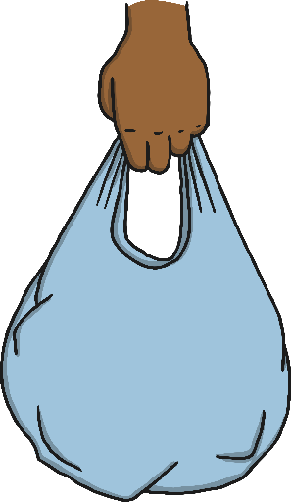
Why Can Plastic Hurt the Planet?
If you threw away an apple core, it wouldn’t be long before the apple completely rotted away to nothing.
Plastic is very strong. When you throw it away, it will be hundreds of years before it rots away to nothing. All the plastic that has ever been made is still where people threw it.

Slide 5
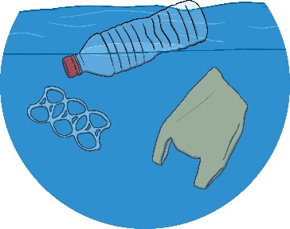
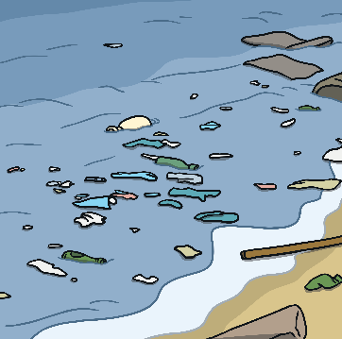
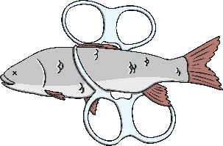
Why Can Plastic Hurt the Planet?
The plastic that has been thrown away is harmful to animals.
Fish can get stuck in plastic as they are swimming in the sea. They then can’t swim properly.
Sometimes, animals think plastic is food and eat it. It then hurts their insides and makes them sick.

Slide 6
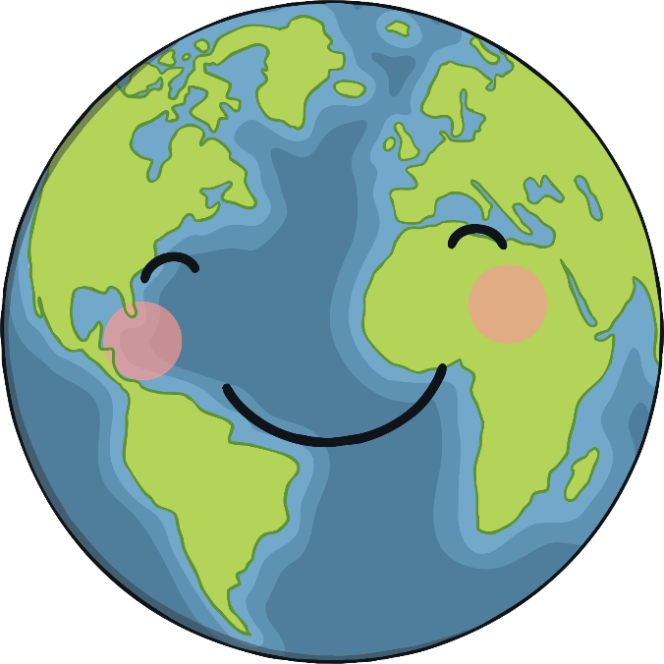
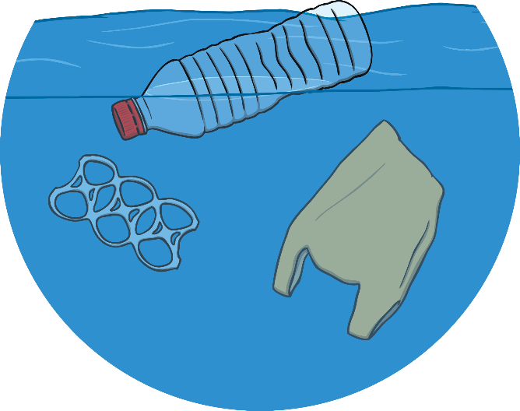
Earth Day
Earth Day is a special time when people think about how to look after our planet. It is on 22nd April.
This year, Earth Day hopes to Restore Our Earth after the pandemic.

Slide 7
What Can We Do on Earth Day?
There are lots of things we can do to help, not only on Earth Day, but all year round.
Reduce
Reuse
Recycle
This means using less plastic. One way you could do this is to not have plastic straws in your drinks.
This means to use things again. Why not fill up a plastic water bottle, instead of getting a new one?
This is when plastic is turned into something new, often by being melted and made into a new shape. Look for the special recycling sign, and put plastic in it.

Slide 8
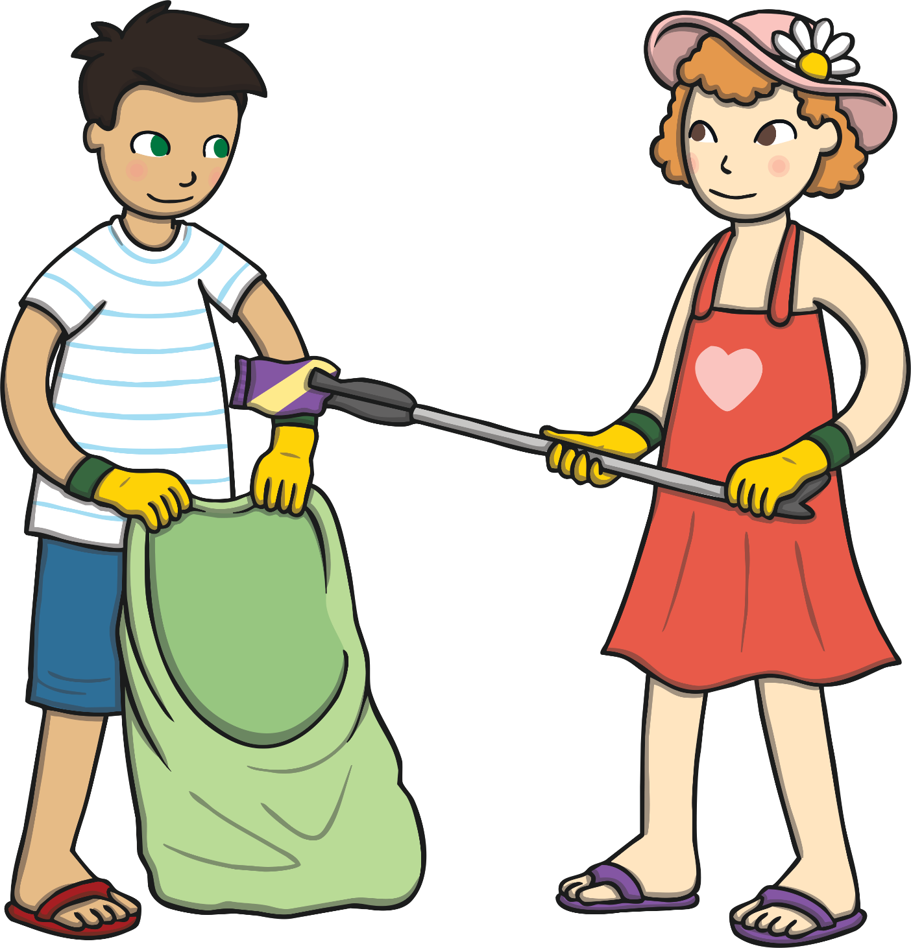
What Can We Do on Earth Day?
Another way you could help is to pick up litter. Make sure you have a grown up with you when you are going this and wash your hands after.

