Slide 1
Welcome to Discovery Class
Mrs Whitworth and Mrs D’Silva – Cocker
2024 - 2025
Notes:
NOTE: To change images on this slide, select a picture and delete it. Then click the Insert Picture icon
in the placeholder to insert your own image.

Slide 2
Typical School Day
We always start the morning with an early morning challenge.
Assembly
English
Maths
Guided reading
Topic – design and technology, art and design, computing, science, history, geography, French and music.
PE for this term will be on a Tuesday – please could children come dressed in their PE kits with earrings removed if they are unable to take them out independently.
Outdoor learning will take place once every half term. This will usually be on the last Wednesday before we break up. Children will need to come in their PE kits with appropriate outdoor provisions.
RE
PSHE

Slide 3
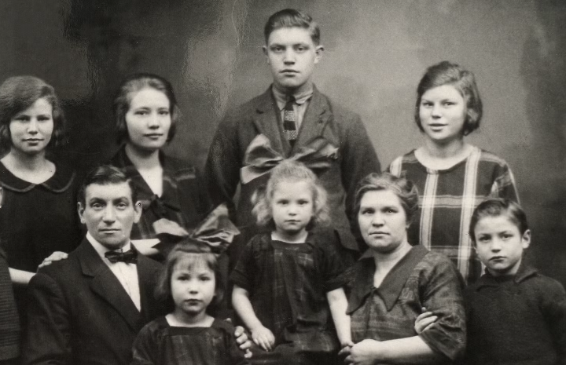
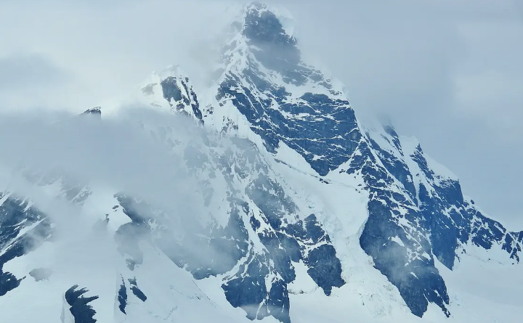
Our Topics
This term we will be exploring the following topics – Children Through Time (history focus) and Antarctica (geography focus).
In Children Through Time we will be exploring the lives of children from Tudor period to the Victorian period.
In Antarctica we will be exploring famous explorers and geographical features.
For more information on our curriculum, please visit the curriculum part of the website.

Slide 4
Our Companion topics.
Art and Design
Printing and mixed media – light and dark.
We will be describing the difference between tint and shade. Using these to paint a 3D object. Our aim is to create a final painting that shows an understanding of how colour can be used to show light and dark, and therefore show three dimensions.
We will also have an artist study day.
Design and Technology
Cooking and nutrition – eating seasonally.
We will design and create a tart recipe using seasonal ingredients. We will also look at the positive effects on eating seasonally on the environment.
Design and Technology cont.
Electricity – torches.
We will design and create a functioning torch with a switch according to their design criteria.
Science
Humans – food and digestion
We will explore the digestive system, types of teeth, producers, predators, prey and food chains.
Energy – electricity and circuits.
We will create circuits, explore conductors, make switches, take precautions and draw circuits.

Slide 5
Spring Term and Summer Term Topics
The Egyptians (history)
Topics linked to the above
Materials – states of matter (science)
Craft and design – ancient Egyptian scrolls (art)
Textiles – fastenings (D&T)
Settlements (geography)
Topics linked to the above
Energy – sound and vibrations (science)
Structure – pavilions (D&T)
Ancient Maya (history)
Topics linked to the above
Animals – classification and changing habitats (science)
Craft and design – the fabric of nature (art)
Winding Rivers (geography)
Topics linked to the above
Making connections – How does the flow of liquid compare? (science)
Drawing – power prints (art)
Mechanical systems – making a slingshot car (D&T)

Slide 6

Reading
We actively encourage reading throughout the school. We believe that it enables a world of possibilities to open before us.
Children will be heard to read at least once every two weeks either by a teacher or a teaching assistant. We keep a record of this.
It would be fantastic if you could take the time to hear you child read the book from school. Hearing your child read will enable them to check to pronunciation of certain words and also check the meaning of unknown words.
This can either be logged by you or by your child.
We expect reading to be logged at least four times a week.

Slide 7
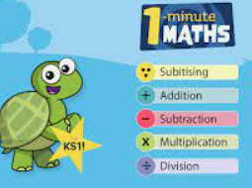

Homework
We are using White Rose Maths in school, to support learning in school we would encourage using WRM 1 minute maths. The app is available to download for free. There is also a link on our class page.
TTRS – we encourage at least 5 minutes per day. Children in Year 4 will partake in the Multiplication Check in June where speed will be essential as only 6 seconds are provided per question. There will be a meeting linked to this on Tuesday 22nd October at 9am.
Spellings – we won’t be sending spellings home. We are practising spellings in class four times each week. There are common exception words on our class page if your child wishes to practice.
Please note – children should bring a healthy snack from home for break time. Please ensure it is nut free.

