Slide 1
Welcome to Blenheim
Mrs Whitworth and Mrs Luck-Davies
2025 - 2026
Notes:
NOTE: To change images on this slide, select a picture and delete it. Then click the Insert Picture icon
in the placeholder to insert your own image.

Slide 2
Typical School Day
We always start the morning with quiet reading
Assembly
English (including focus reading)
Maths
Guided reading
Topic – design and technology, art and design, computing, science, history, geography, French and music.
PE for this term will be on a Tuesday – please could children come dressed in their PE kits with earrings removed if they are unable to take them out independently.
Outdoor learning will take place once every term. This will usually be on the last Wednesday or Thursday before we break up. Children will need to come in their PE kits with appropriate outdoor provisions.
RE
PSHE

Slide 3
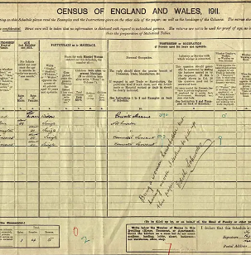
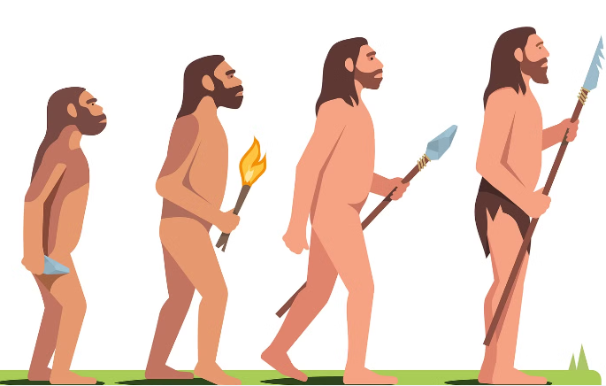
Our Topics
This term we will be exploring the following topics – Who lived in a village like this? (history focus) and Darwin’s Daring Discoveries (science focus).
In Who lived in a village like this? We will be exploring the importance of the census, the suffrage movement and what it can tell us about lives during Victorian times.
In Darwin’s Daring Discoveries, we will be exploring evolution and inheritance using fossil evidence to support our understanding.
For more information on our curriculum, please visit the curriculum part of the website.

Slide 4
Our Companion topics.
Art and Design
Painting: portraits
We will develop our painting skills using images of ourselves as a starting point to create unique self portraits.
We will also have an artist study day.
Design and Technology
Mechanical systems: gears and pulleys
We will explore and design our own gear and pulley systems to enable us to create an eco gadget bike design.
Design and Technology cont.
Digital world: navigating the world
We will program a navigation tool to create a multifunctional tool for trekkers.
Science
Materials: mixtures and separation
We will explore explores, how things dissolve and design our own water filter.
Living things: evolution and inheritance
We will study patterns in species, look at what is inherited and gained from the environment and explore Darwin’s theories.

Slide 5
Spring Term and Summer Term Topics
Who let the Gods out? (history)
Topics linked to the above
Living things: life cycles and reproduction (science)
Craft and design: photo opportunity (art)
Cooking and nutrition: come dine with me (D&T)
Secrets of the deep – ocean odyssey (geography)
Topics linked to the above
Energy: light and reflection (science)
Structures: bridges (D&T)
Icons of history (history)
Topics linked to the above
Animals: circulation and health (science)
Sculpture and design: interactive installation (art)
Textiles: waistcoats (D&T)
The great local challenge (geography)
Topics linked to the above
Making connections: Are some sunglasses safer than others? (science)
Drawing: make my voice heard (art)
Electrical systems: steady hand game (D&T)

Slide 6

Reading and homework
We actively encourage reading throughout the school. We believe that it enables a world of possibilities to open before us.
Children will be working their way through their ZPD level initially choosing a book from the lower part before moving onto the more challenging within their range.
We expect reading to be logged at least four times a week. This can either be logged by you or by your child.
With reading being assessed in their SATs, it is essential that children are heard to read at home to ensure they understand the text and can answer questions linked to what they have read.
Homework will be given out in due course.

Slide 7
Mobile phones and Whatsapp
Mobile phones must be turned off before entering the playground at the beginning of the day and placed in the office when children come into class. These will then be collected at the end of the day, they must remain off until they have left the playground.
Whatsapp – although this provides a fun and exciting way to keep in touch, unfortunately it has caused problems in the past. If a group for the class (children) is set up, there needs to be an adult who takes responsibility for monitoring messages that are sent. Sadly messages in the past have been unmonitored and this has led to unkindness which has previously filtered into the classroom.

Slide 8
Additional information
There will be an additional meeting for parents of children in Year 6 on Wednesday 8th October linked to SATS.
Children are welcome to bring in a healthy snack for playtime – please ensure it is nut free.
Please ring the absence line to report any absence from school rather than sending an email.
If you have any questions or queries throughout the year, please do not hesitate to contact me using the following email address.
lwhitworth@bradfield.essex.sch.uk

