Slide 1
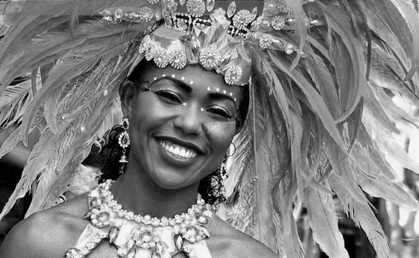
Rio de Vida – My Learning Journey.
Geography
Identify
Locate Brazil and its capital city. Compare with the UK.
Find out
Identify flags from around the world. Make own for an event.
Art and Design
Describe
Create a headdress for a samba parade.
Describe
Explore the colours and textures of a carnival using collage.
Describe
Make a seasonal celebration card.
Memorable experience – Carnival dance experience.
Express event – Brazilian carnival to welcome the new season.
Design and Technology
Draw and label
Research then create own percussion instruments.
Select and explain
Cut, stick or stitch flags.
Talk
Make traditional Brazilian celebratory cakes. Explain likes and dislikes.
Music
Listen
Explore music played during a carnival.
Make
Explore how percussion sounds are made.
Sing
Write and perform a song linked to Brazilian mythology.
Listen
Listen and explore the importance of a national anthem.
Sing
Listen to seasonal songs making percussion sounds to match music.

Slide 2
Rio de Vida – My Learning Journey.
PSHE
Take part
Talk about and create a list of celebrations held around the world.
Take part
Learn and use Portuguese greetings.
Take part
Talk and list seasonal celebrations and which ones are preferred and why.
Memorable experience – Carnival dance experience.
Express event – Brazilian carnival to welcome the new season.

