Slide 1
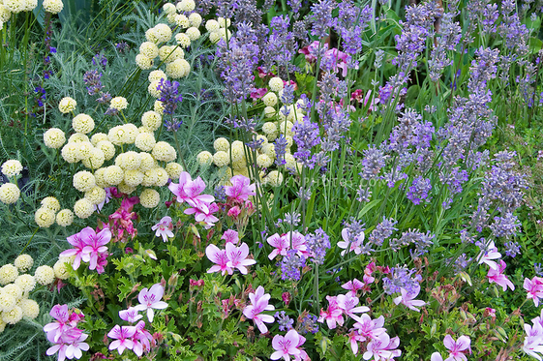
Scented Garden – My Learning Journey.
Geography
Draw
Find and map the plants found using a key.
Use information
Compare and contrast plants living in other parts of the world.
Use scientific language
Find and use the senses. Explore what happens when one is taken away.
Describe
Grow a windowsill garden.
Science
Group
Explore smells using sensory bags.
Decide and group
Locate and name parts of a flower
Use equipment
Observe how plants transport water.
Use equipment
Explore a range of garden herbs using the senses.
Decide and group
Locate and name parts of a flower
Use equipment
Follow instructions to create a mini rainforest.
Memorable experience – Gardener talk.l.
Express event – Making scented products .
Art and Design
Use line and tone
Create observational drawings of scented flowers.
Model
Use wire to create rainforest leaves and flowers.
Explain
Press and write instructions to explain.
Choose
Create a floral collage inspired by a famous artist.
Design and Technology
Use tools
Create and use a mud kitchen.
Select and explain
Make and use scented playdough.
Design and draw
Plan a fantasy garden.

Slide 2
Scented Garden – My Learning Journey.
Geography
Organise, manipulate and save
Create a PowerPoint to show all that has been learnt.
Memorable experience – Gardener talk.l.
Express event – Making scented products .

