Slide 1
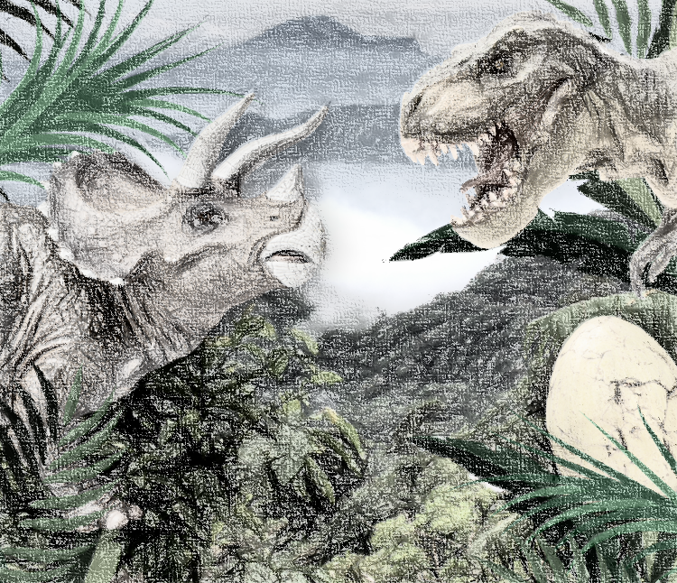
Dinosaur Planet – My Learning Journey.
History
Suggest ideas and ask questions
Explore fossils, what they look and feel like and what they once were.
Explore a historical figure
Find out information about Mary Anning.
Describe similarities and differences
Explore what life was like during the age of the dinosaurs.
Suggest ideas and ask questions
Explore how and why the dinosaurs died out.
Organise information
Present the information that has been discovered.
Science
Classify and sort
Draw, label and research about reptiles.
Identify
Sort teeth into those from a herbivore and a carnivore.
Identify
Identify the main parts of a dinosaur skeleton.
Identify
Search for plants that lived during the age of the dinosaurs.
Memorable experience – Dinosaur hunt around the school.
Express event – Dinosaur movie premiere .
Art and Design
Describe
Create a large scale dinosaur, talking about what has been created.
Create
Make a dinosaur egg.
Create
Make dinosaur fossils.
Design and Technology
Select and explain
Create a ‘sockasaurus Rex’.
Select and explain
Hold a class dinosaur party (including food).

Slide 2
Computing
Give instructions
Program a floor turtle to visit a dinosaur world.
Follow instructions
Create a dinosaur movie.
Geography
Find and name
Identify animals that are at risk of extinction and mark where they live on a map.
Memorable experience – Dinosaur hunt around the school.
Express event – Dinosaur movie premiere .

